Slide 1
Revolutionizing the Economics of AI Infrastructure
Liqid Composable Overview

Slide 2


Slide 3
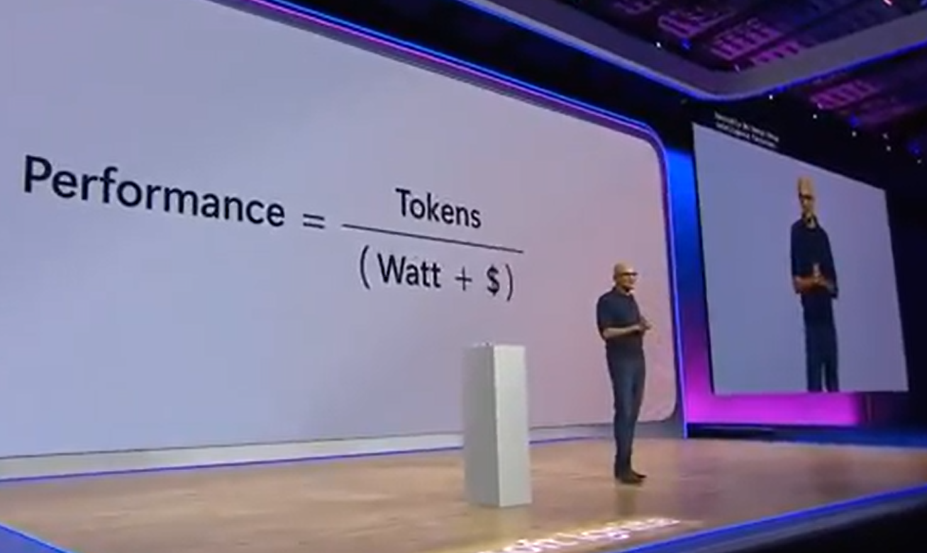
The New “Currency” of Datacenter Performance

Slide 4




Powerful and Efficient AI Infrastructure
Conventional AI Servers
Dynamically Configured AI Servers
10 GPUs
Liqid Composable
Software & Fabric

Slide 5
Powerful and Efficient AI Infrastructure
Conventional AI Servers
Dynamically Configured AI Servers
20 GPUs
10 GPUs
Liqid Composable
Software & Fabric

Slide 6
Powerful and Efficient AI Infrastructure
Conventional AI Servers
Dynamically Configured AI Servers
20 GPUs
10 GPUs
Liqid Composable
Software & Fabric
Low GPU Density
High Power/TCO
Limited Flexibility
Maximum GPU Density
Lowest Power/Cooling
Silicon Diversity

Slide 7
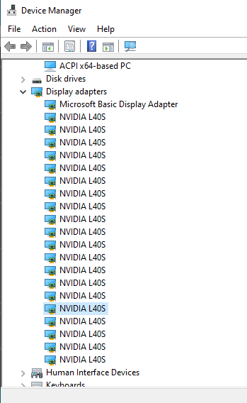
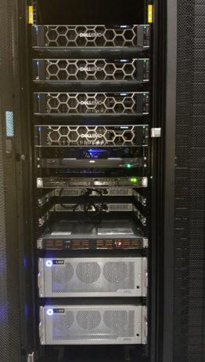
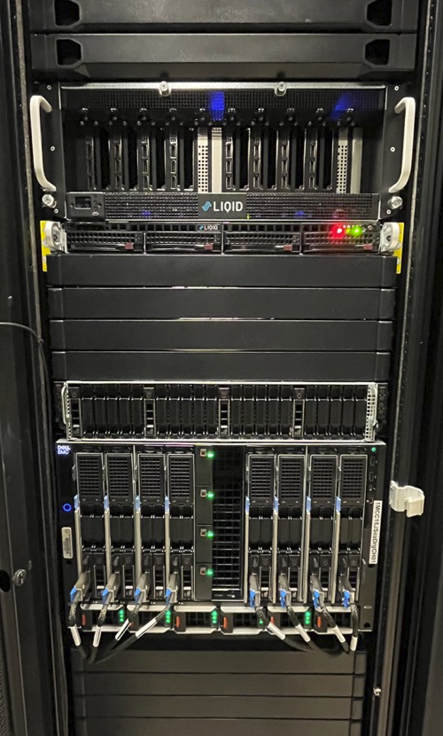
Liqid Customer Use Cases

Slide 8


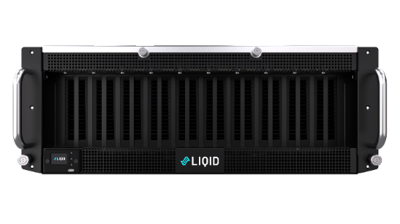

Superior Performance with Reduced Power
4x 4-GPU Servers
1x 16-GPU UltraStack
Task: LLM / Data: CNN-DailyMail News / Model: gptj-99
Total Servers | 4x | 1x
Total GPUs | 16x | 16x
Software Cost | 4x | 1x
Networking Cost | 4x | 1x
Performance | 74 | 94
Power | ~12,000 | ~7500
MLPerf 3.1 Large Language Model Inference - Queries/second
Dell PowerEdge R660 or R760 (L40S, TensorRT)
MLCommons MLPerf test suite – Rev 3.1
Non GPU Power is ~1250W for 8x GPU Server and ~1750 for 20x UltraStack
https://mlcommons.org/en/inference-datacenter-31/
6.2 Ops/kW
12.5 Ops/kW
~75% Reduction Servers & Power
~75% Reduction SW & Networking
2x Higher Ops/W
Best in Class TCO

Slide 9
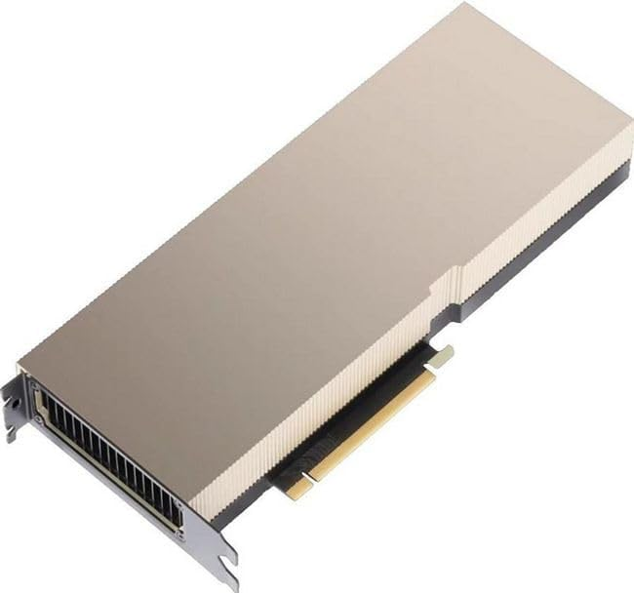



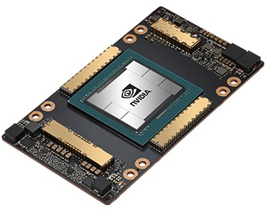

Revolutionizing AI Efficiency
7kW GPU Performance & Efficiency Comparison
16x PCIe vs. 8x SXM
Energy, not compute, will be
the #1 bottleneck to AI progress.
- Mark Zuckerberg
A100 PCIe GPU
16x @350W/each
~4.9 Ops/W
A100 SXM GPU
8x @700W/each
~3.1 Ops/W
ResNet50: Images/Sec
150% More Operations per Watt
50% More Images per Second

Slide 10
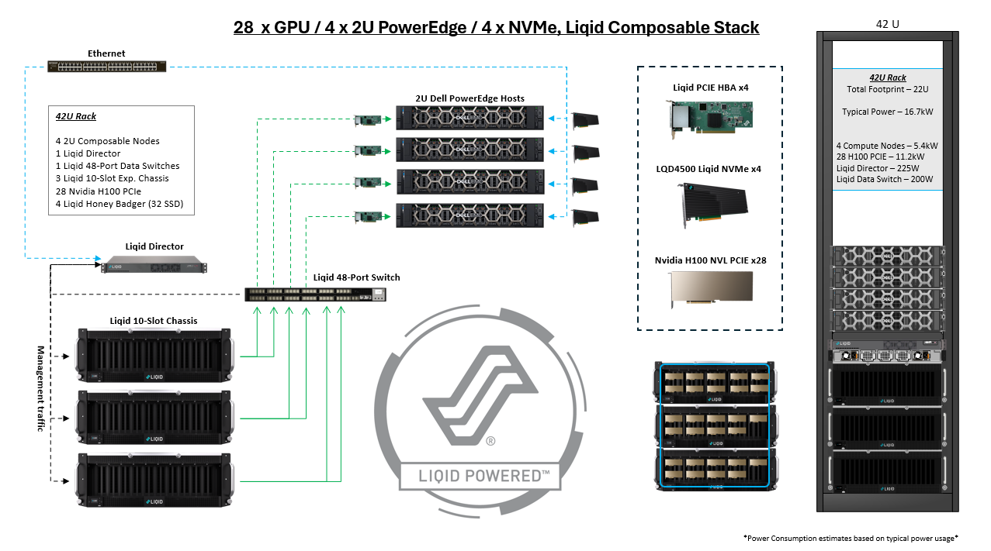
Power Savings via GPU Composability

Slide 11

Versatile GPU Solutions: Flexibility and High-Density
SmartStack
Multi-Server GPU-on-Demand
Focused on Pooling & Sharing
Enables Silicon Diversity
UltraStack
High Density GPU Server Node
Focused on GPU Performance
Best in Class Ops/W + Ops/$
 | Small | Medium | Large | XL
SmartStack | SmartStack 10: 10x GPU / 4x Hosts | SmartStack 20: 20x GPU / 8x Hosts | SmartStack 30: 30x GPU / 6x Hosts | SmartStack 30+: 30 GPU / 16x Hosts
UltraStack | UltraStack 10: 10x GPU / 1x Host | UltraStack 20: 20x GPU / 1x Host | UltraStack 30: 30x GPU / 1x Host | -

Slide 12
Thank you!

